Slide 1
A Cost Efficient Content Distribution Optimization Model for FOg-Based CDNs
Nidhi Bhansali- 16010122018
Rishil Desai- 16010122038
Soumil Dhywershetty-16010122048
Jeet Gada- 16010122053

Slide 2
Introduction
The growing dependence of the global population on the internet has caused much higher data consumption, and video content alone drives up to 80% of the world's traffic. Conventional Content Delivery Networks (CDNs) that are based on centralized cloud data centers are not scalable, particularly in the wake of fast-paced mobile device and user expansion. These constraints make it imperative to turn to fog computing-based Content Delivery Networks (Fog-CDNs). Fog computing has the potential to provide enhanced performance and affordability by placing content nearer to the user at the network edge. This paper suggests an optimization model for content distribution in Fog-CDNs to deal with the increasing need for effective content delivery with lower costs.

Slide 3
Research Objectives
The study seeks to solve three fundamental goals in the context of Fog-CDNs. First, it seeks to identify the best placement of fog nodes in the network. Second, it seeks to create an effective content distribution plan that reduces delivery time and resource consumption. Third, the model seeks to reduce the total operational cost of the Fog-CDN system while maintaining Quality of Service (QoS) requirements.

Slide 4
System Model Overview
The system model presented in the paper consists of a number of important components. These are a Centralized Cloud Content Provider (CCP), which holds and distributes content, a number of fog nodes distributed across different geographic locations, and Open Public Wi-Fi Access Points (OPWAPs) that act as edge access points for users. The difficulty is to decide where the fog nodes should be placed to meet the trade-off between cost and performance. The objective is to make sure content is delivered efficiently to end-users with the goal of reducing the total cost of network infrastructure deployment and maintenance. The model also includes link capacity and storage constraints.

Slide 5
Mathematical Formulation
The optimization problem is defined mathematically, and decision variables control the deployment of fog nodes and distribution of content over the network. The model employs a binary decision variable,D(r,p,n)​ which is an indicator of whether a fog node is deployed at a given position. The objective function aims to minimize the total cost, which is comprised of placement costs, replication costs (upload, download, and storage costs), and operation costs. The formulation further consists of multiple constraints to satisfy Quality of Service (QoS) requirements, not to violate network link capacities, and not to violate storage capacity at fog nodes.

Slide 6
Problem Statement
We then shift our focus to the most pressing issues confronting CDNs in the present time. More than 60% of CDN operational costs are derived from cloud bandwidth utilization. Moreover, prevailing models waste unused fog resources, and most of the available solutions sacrifice both latency and QoS for cost-effectiveness. Our research target is to devise an optimization model that minimizes cost while guaranteeing QoS, including latency constraints and cache hit ratios. A graphic infographic summarizes the major issues and how our model solves them.

Slide 7
System Architecture
The system structure falls into the three layers: the end-user layer (such as phones, sensors, and IoT devices), the fog layer (that handles localized caching and processing), and the cloud layer (serving as a backup for less frequently accessed content). The model encompasses dynamic routing of content requests according to latency and cost. It is easy to understand these interactions through a layered diagram with arrows showing real-time data flow among users, fog nodes, and the cloud.

Slide 8
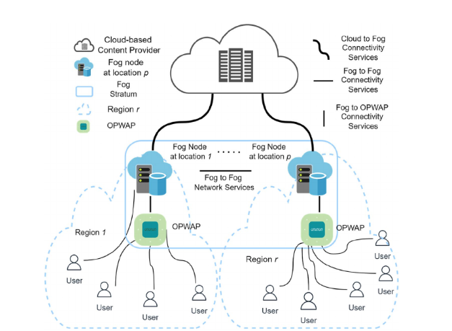
System Architecture
.

Slide 9
Optimization Model
Our cost-efficient optimization model aims to minimize the total content distribution cost, represented as:
Total Cost=α⋅Storage+β⋅Bandwidth+γ⋅Latency
Here, α,β,γ are weights assigned based on QoS priorities. The model includes constraints such as fog node storage limits and maximum allowable latency per user request (e.g., less than 100ms). The key equation is emphasized with color-coded variables to aid clarity and interpretation.

Slide 10
Methodology
We detail our stepwise methodology: First, request routing is performed using Dijkstra’s algorithm, which identifies the lowest-cost fog node to serve a user request. Second, we implement an LFU (Least Frequently Used) caching policy that adapts to dynamic content popularity. Third, we ensure load balancing across fog nodes through a weighted round-robin algorithm, taking each node's capacity into account. This workflow is visualized using a clear, annotated flowchart.

Slide 11
Simulation Setup
To validate the model, we use iFogSim for fog network simulation and MATLAB for optimization tasks. Our experiments involve 100–500 fog nodes and utilize real-world content request traces, such as those from the Netflix dataset. We benchmark our results against three baselines: traditional CDN models, cloud-only setups, and static fog caching strategies. A screenshot or table displays the simulation parameters for transparency and reproducibility.

Slide 12
Results
The results highlight the effectiveness of our model. Cost per request drops from $0.05 in cloud-CDNs to $0.02 using our fog-CDN approach. Average latency decreases from 120ms to 50ms. Additionally, the cache hit ratio at fog nodes improves significantly, reaching 80% compared to 40% in traditional setups. These performance improvements are visualized using bar charts that contrast key metrics across different models.

Slide 13
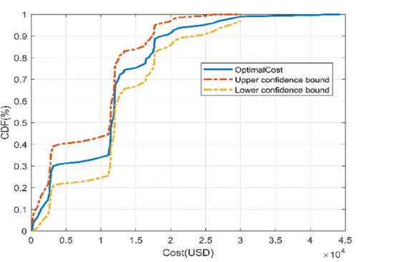
Results
.

Slide 14
Advantages
From a practical perspective, our model has significant benefits. Economically, it could save $1 million per year for a mid-sized CDN provider. Technically, it enables support for 10,000+ concurrent IoT devices per fog cluster. From a sustainability angle, it reduces energy consumption by 25% compared to centralized models. These impacts are represented using meaningful icons: a dollar sign for cost, an IoT symbol for scale, and a leaf for sustainability.

Slide 15
Challenges
We also acknowledge the limitations and challenges of our approach. Heterogeneity in fog nodes (from low-power Raspberry Pi devices to industrial gateways) complicates standardization. Security becomes a concern as distributed caching introduces a larger attack surface, requiring robust encryption. Additionally, managing dynamic content remains complex, as it necessitates accurate, real-time popularity prediction. A warning icon and lock symbol accompany these discussion points.

Slide 16
Conclusion
To conclude, our fog-based CDN optimization model demonstrates clear benefits, reducing overall costs by 40% and latency by 35%. The broader impact is profound—it enables scalable solutions for smart cities, Industry 4.0, and metaverse platforms that demand real-time content distribution.

Slide 17
Thank You
.

